Slide 1

AI transcends beyond different fields such as medicine, engineering, architecture and most importantly education
“AI revolutionized how we
learn and think today”

Slide 2
What is AI?
AI is a discipline that attempts at creating
intelligent machines
What is Intelligent Machines?
able to interact with the world by means of speech, vision, and motion
able to create a model of the world where it may reason and adapt in it
able to self learn and teach itself new tasks

Slide 3

The Recommended Channels on YouTube utilizes AI techniques
such as data mining and pattern recognition
Recommended Channels

Slide 4
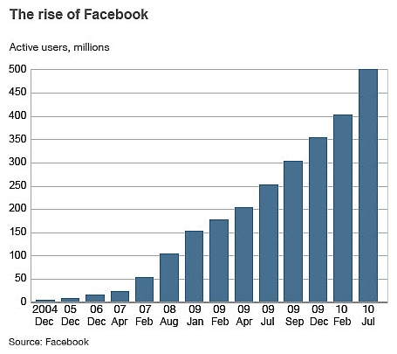
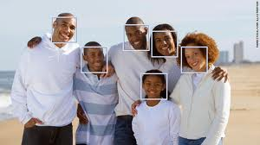
FACEBOOK
The Facebook Face Detection
The Facebook User Statistics
Advertisement = Money!

Slide 5
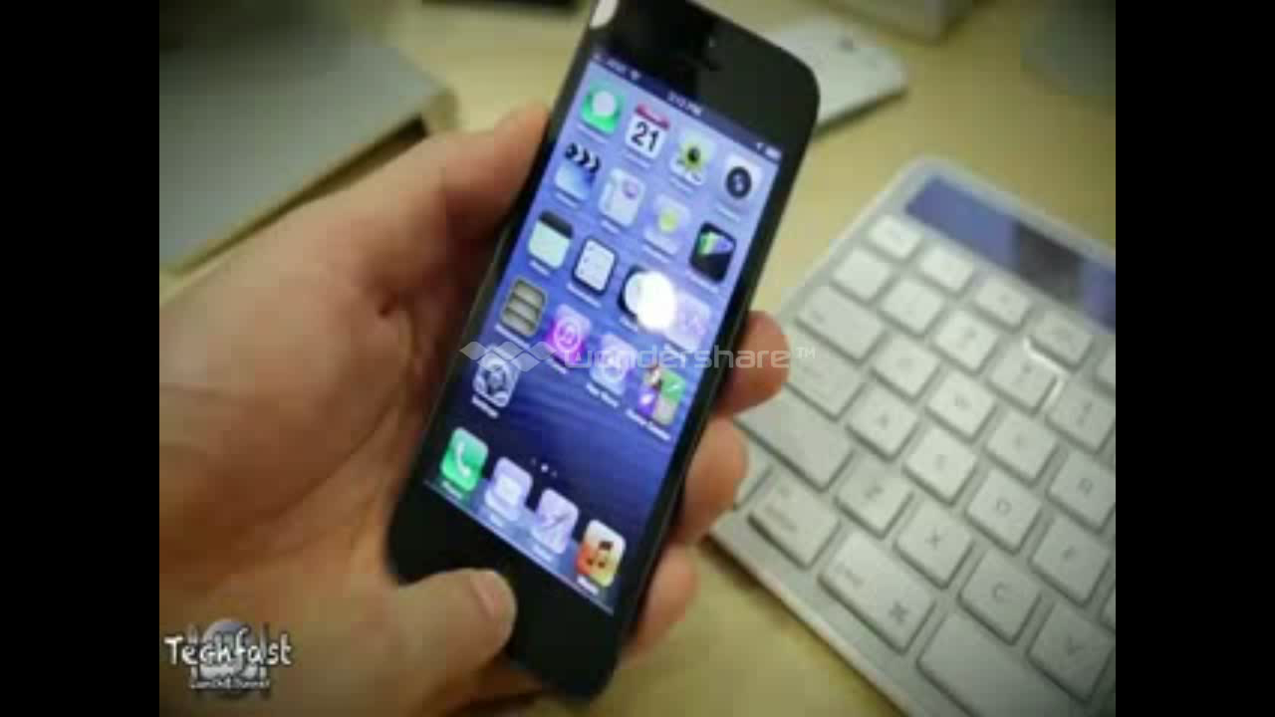
Voice Recognition
&
Human-Computer Interface
Tweet Something
Insert Siri 1+2 AVI
.. score of the Angel’s game?

Slide 6
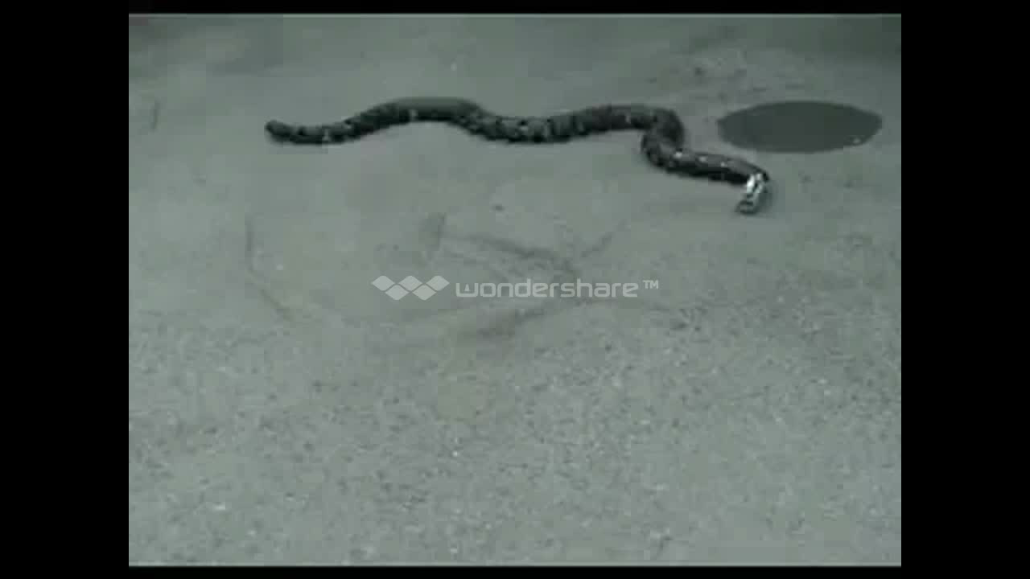
AI mimics basic living organisms (animals) to more advanced types of mimicry (human)
Insert AI 1+2+3 AVI

Slide 7
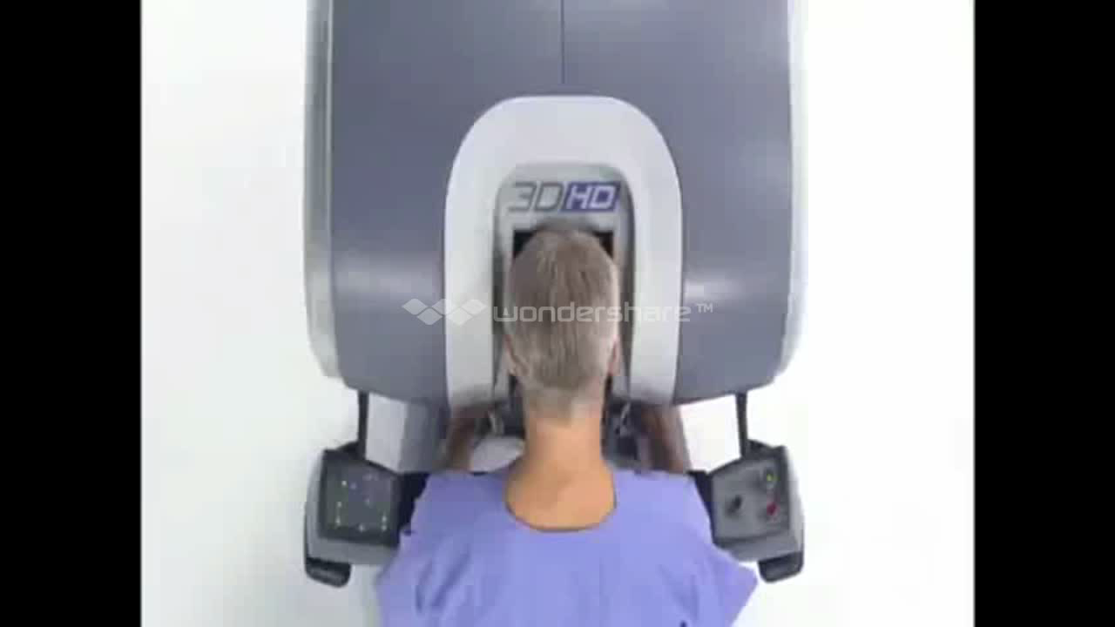
AI revolutionized the Medical Field
Insert Robotic_Surgery 1+2 AVI

Slide 8
We covers the AI Foundation
at our Department
Neural Network
Machine Learning
Natural Computing
Expert Systems
Computer Vision
Natural Language Processing
Fuzzy Logic
Cognitive Science
Robotics

Slide 9
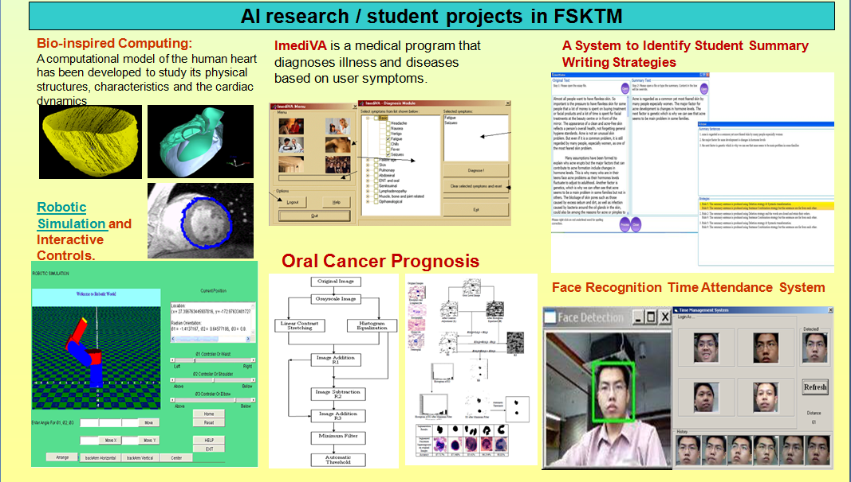
Current Research & Projects at the Department

Slide 10
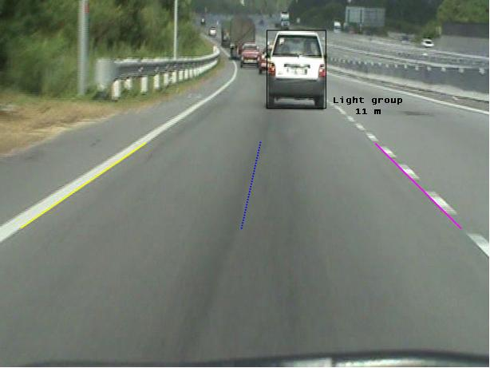
Lane Detection System
Insert final_vid

Slide 11
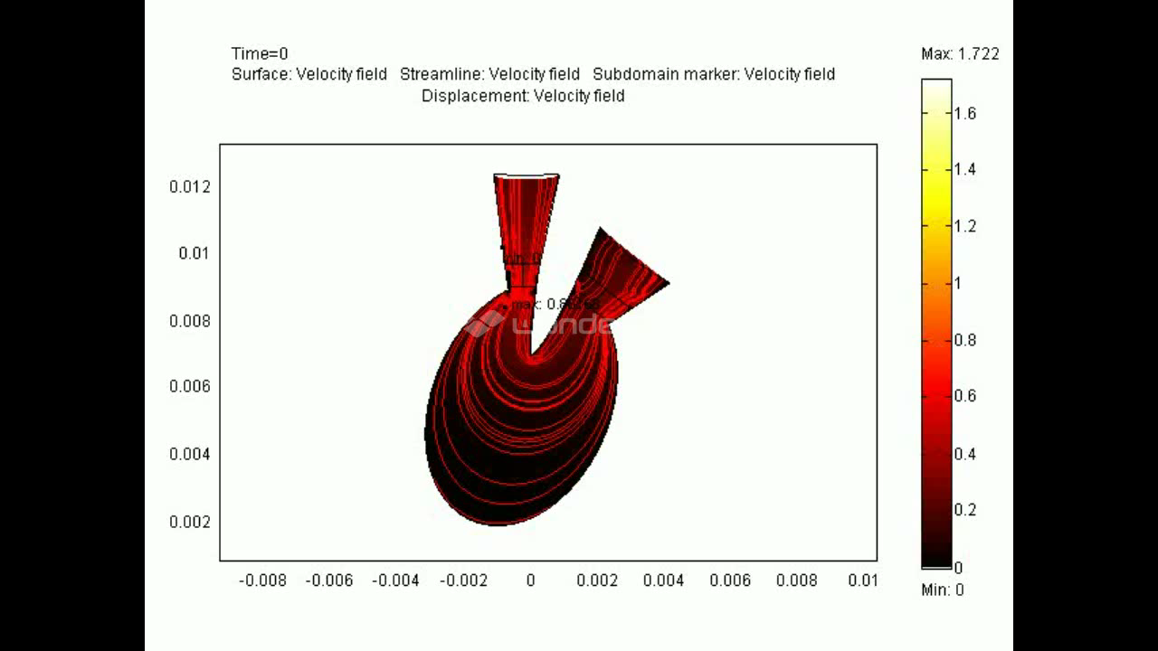
Medical Image Processing
Insert Valve AVI

Slide 12

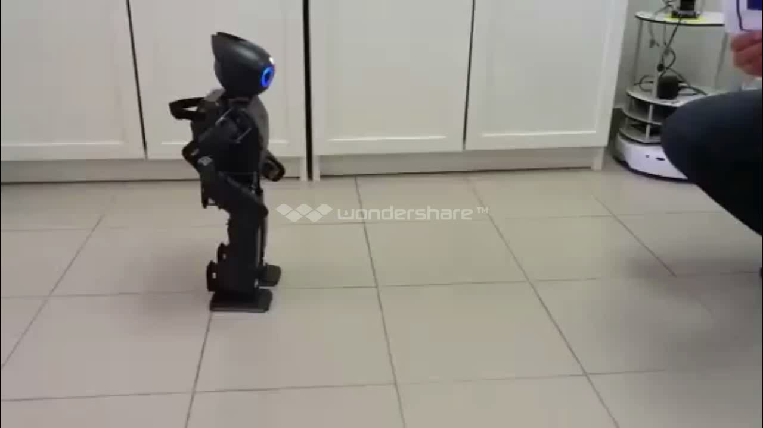
Robotics – Object Tracking
Insert Darwin Ball

Slide 13
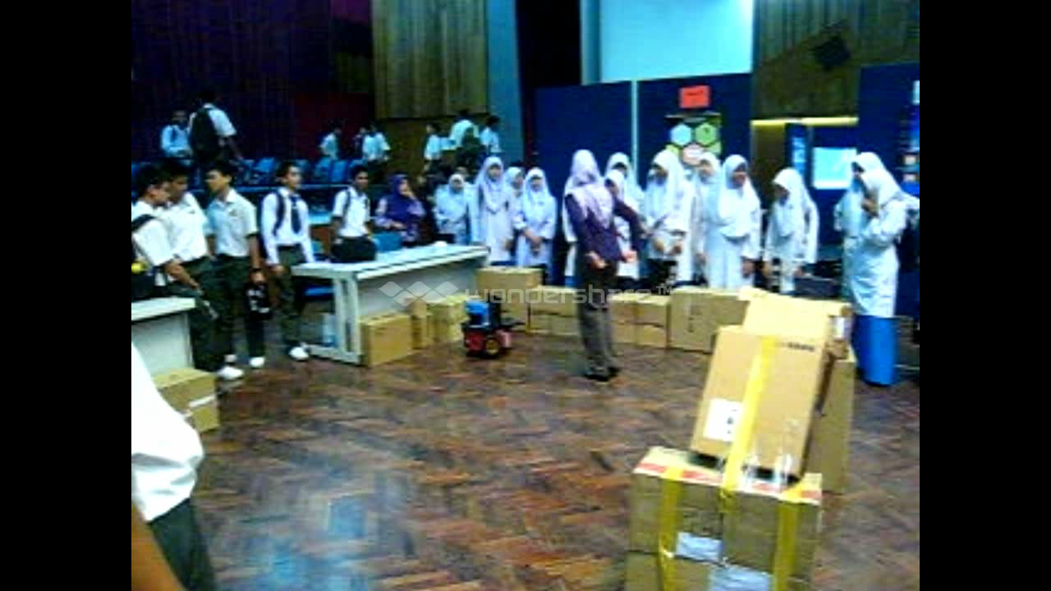
Robotics – Obstacle Avoidance
Insert PiTUM Demo

